Slide 1

MARKETING PROJECT
GROUP MEMBERS
Musab Khan(20B-068-CS)
Faiqa(20B-105-CS)
Saif(20B-083-CS)

Slide 2
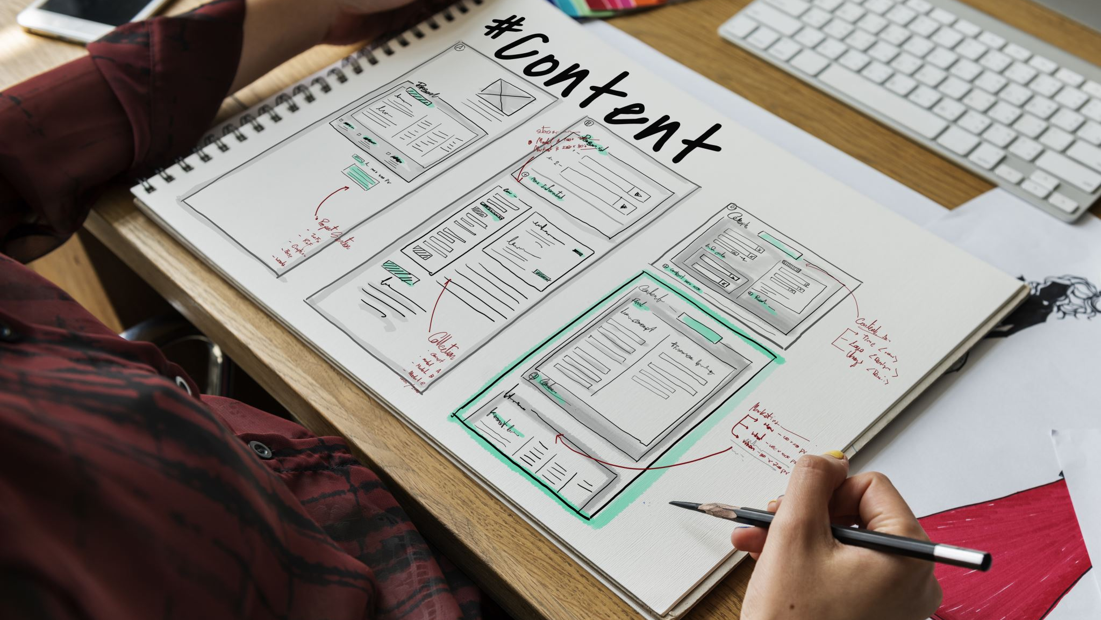
BUSINESS PLAN
What Are We Selling?
We have a wide variety of innovative and handmade resin items, goodie bags, keychains, bookmarks, and more
Who Are We Selling To?
Our target market includes teenagers, small fabric industries, event planning organizations and people who enjoy arts and crafts
How Are We Sourcing our Product?
We precisely craft all of our products in-house, We source our materials sustainably, and our manufacturing procedures reflect our dedication to sustainability.

Slide 3
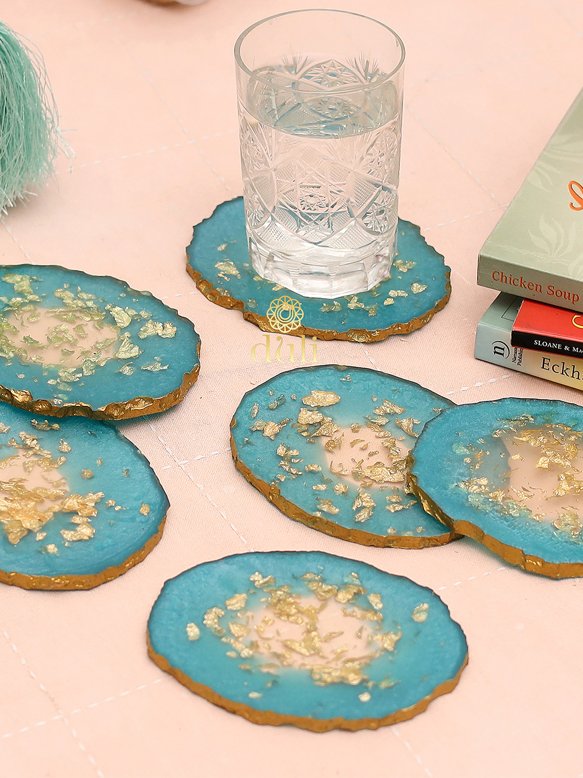
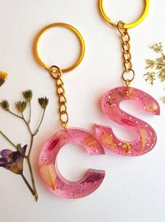

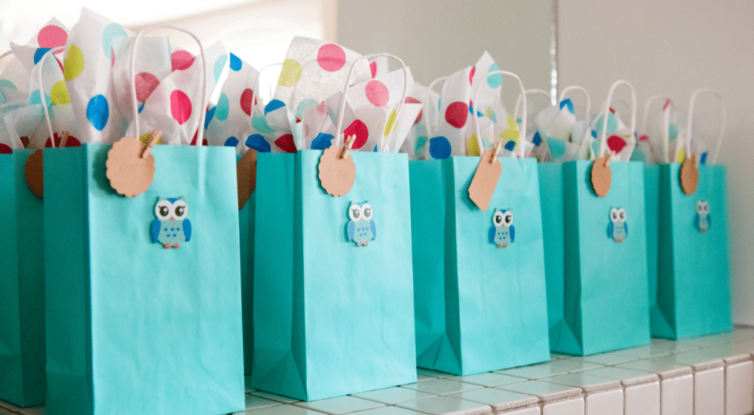

PRODUCT SHOWCASE
Coaster
Key Chain
Bookmark
Goodie Bag

Slide 4
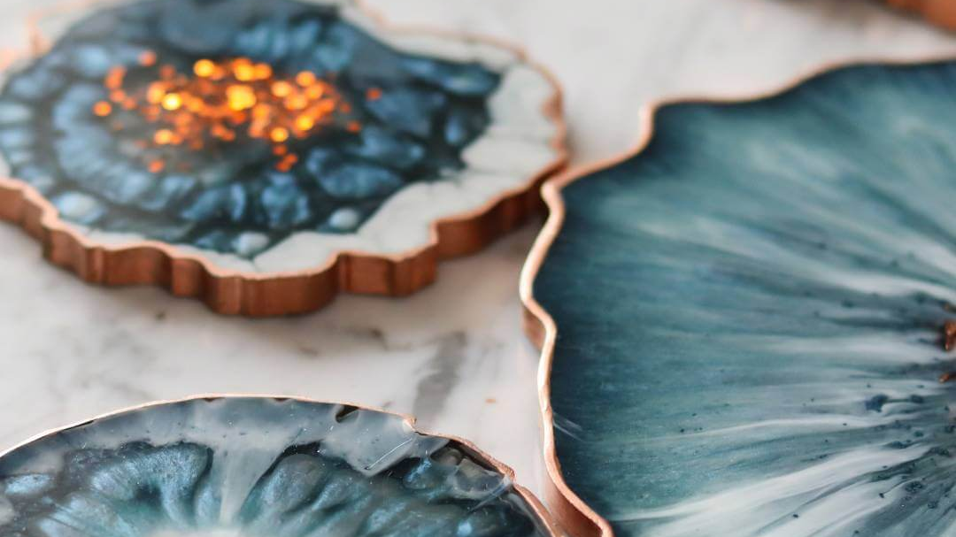
Business Overview
Our business is a dynamic e-commerce business that specializes in the sale of custom art and craft items as resin masterpieces, goodie bags, keychains, bookmarks
Brand Name: Resinique
Founder/Owner (CEO): Saif-ur-rehman
Company Type
Resinique is a partnership of three individuals who share all of the company's responsibilities, liabilities, profit and loss, and management control.
Mission
Our devotion to establishing a thriving artistic community Vision
Resinique hopes to become a National leader in the art and craft e-commerce sector in the next 5 years

Slide 5
DESIGNATION
Founder/Owner (CEO): Saif-ur-rehman
Creative Director/Designer: Saif-ur-rehman, Faiqa Talib, Musab Khan
Customer Service/Logistics: Faiqa Talib
Marketing Manager: Faiqa Talib
Production Manager/Craftsman: Musab Khan
Sales Manager: Musab Khan
Finance/Accounting: Saif-ur-rehman
E-commerce Specialist: Saif-ur-rehman

Slide 6
EXECUTIVE SUMMARY OF BUSINESS MODEL
Product Range
Our diversified catalogue features a wide range of handcrafted products
Customization
We distinguish ourselves by offering a one-of-a-kind customization service that allows consumers
Market Focus
Resinique targets youth, small fabric industries, event planning organizations and arts and crafts lovers in both B2B and B2C areas
Sales Models
Orders and payments are secured through a variety of channels, including online transactions via JazzCash, EasyPaisaor other fintech, We also provide the option of paying cash on delivery

Slide 7
CONTINUE
Product/Industry
Our focus is on delivering unique and artistic expressions that engage with our clients, from customizable resin products to curated goodie bags, keychains, and bookmarks.
Target Market
Teenagers, small fabric enterprises, and those with a keen interest in arts and crafts are our key target markets.
Sales Channel
Resinique is active on Instagram and Facebook, and we use these social media platforms as our key sales channels. Our website allows customers to easily browse, order, and customize products

Slide 8
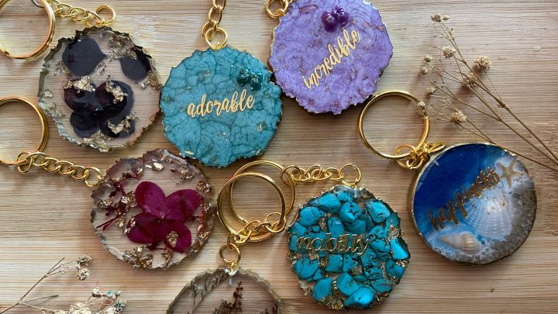
MARKET ANALYSIS
Competitive Market Analysis
This crucial component of our business plan goes into the complexities of our industry, , the competitive forces at work, and a thorough understanding of our target consumer demographic
ExistingCompetition
resinartbyainaat:
Strengths: Include artistic resin creations and a well-established brand presence.
Weaknesses: Include a limited product offering and potential scalability issues.
madiha_safaa_resin:
Strengths: Include smaller market presence, potential for larger offers.
craftsbynahima:
Strengths: Includes a wide range of handcrafted objects, with the potential for distinctive designs.
Weaknesses: There may be a lack of a specific focus on resin products, as well as opportunity for specialization.

Slide 9
SWOT ANALYSIS
Strength: Unique and Handcrafted Products Customization and Personalization Online Presence and Social Media Engagement Direct Interaction with Customers Operational Flexibility | Weaknesses: Limited Product Range Limited Marketing Budget Dependency on Online Platforms
Opportunities: Market Expansion Collaborations and Partnerships Diversification of Product Line | Threats: Competition from Established Brands Supply Chain Disruptions Economic Downturn

Slide 10
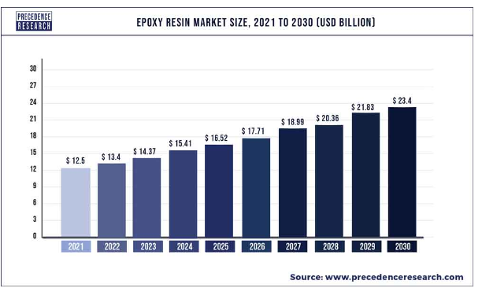
INDUSTRY REPORT
The global epoxy resin market size was estimated at USD 12.5 billion in 2021 and is expected to hit around USD 23.4 billion by 2030 and expanding growth at a compound annual growth rate (CAGR) of 7.22% during the forecast period 2022 to 2030. U.S. epoxy resin market was valued at USD 2.1 billion in 2022.

Slide 11
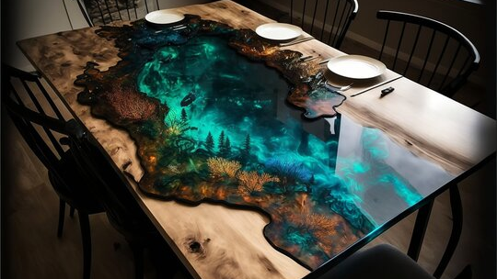
Market Segment
Teenagers: Young people who want to express themselves through trendy and personalized art and craft things. Our offers appeal to their quest for distinctive and expressive products.
Small Fabric Industries: Companies in the events and promotions business looking for customizable goods to boost their brand's visibility. CraftVista offers a creative alternative for creating one-of-a-kind and memorable event items.
Arts and Crafts Enthusiast: Individuals driven by a passion for one-of-a-kind, handmade goods who build a community around shared interests are known as arts and crafts enthusiasts. Resinique is a gathering place for like-minded people to find and acquire one-of-a-kind items.
Event Planning Organizations: Professional event planners and organizations seeking unique, innovative goods to enhance the visual appeal and theme of events. Resinique works with event planners to produce customizable items with a unique flair for different occasions.

Slide 12
Marketing of the Company
Product
Resinique's product strategy is around providing a broad and unique range of handcrafted things, with a focus on resin products, goodie bags, keychains, and bookmarks
Price
Resinique employs a competitive pricing strategy to ensure that its handcrafted items are economically priced while reflecting the quality, craftsmanship, and value offered by customization. The pricing structure is explicit,
Place
Resinique largely works through online platforms, with a strong online presence on social media sites such as Instagram and Facebook
Promotion
Resinique's promotion strategy is centered on active social media involvement, with visually appealing material used to highlight items, engage with the audience, and develop a feeling of community around the brand Products and Offers

Slide 13
Marketing Plan and Operations
Age group: Mostly aimed to teenagers and others interested in arts and crafts.
Location: For convenience of delivery, we are concentrating on in-city customers.
Population: A niche population of art and craft enthusiasts is being targeted.
Education Level: Tailoring marketing to appeal to people with a wide range of educational backgrounds.
Income Level: The restaurant caters to a wide range of income levels, particularly youngsters with discretionary income.
Pain Points: Identifying difficulties in locating unique, personalized art and craft products.

Slide 14
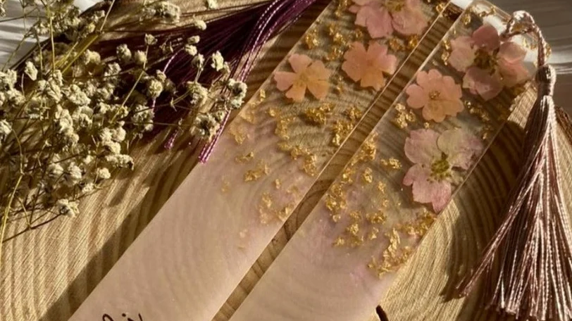
Organic Marketing
Social media (Instagram & Whatsapp)
Resinique uses social media network to carefully exhibit its visually stunning products. Instagram & Whatsapp groups, in example, are used as venues for audience engagement, sharing behind-the-scenes content, and running promotions.
Blogger networks
Resinique has deliberately engaged with influential bloggers and social media influencers, which has resulted in a considerable increase in organic reach.

Slide 15
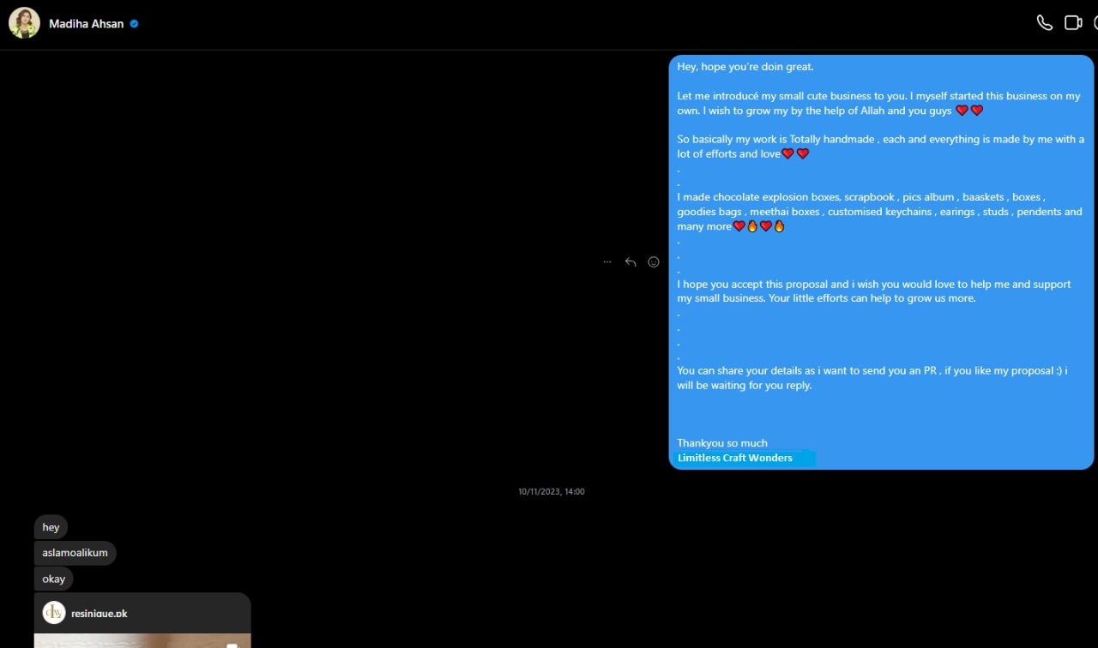

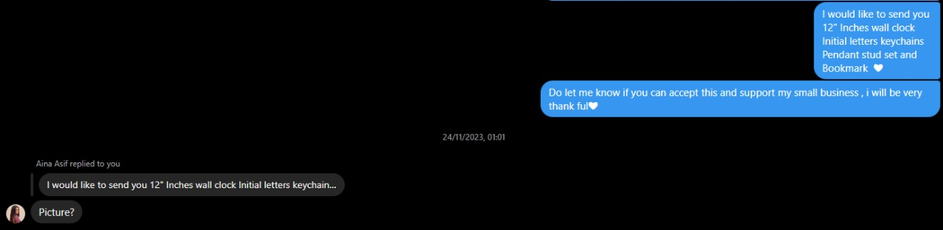
FAMOUS REACH

Slide 16
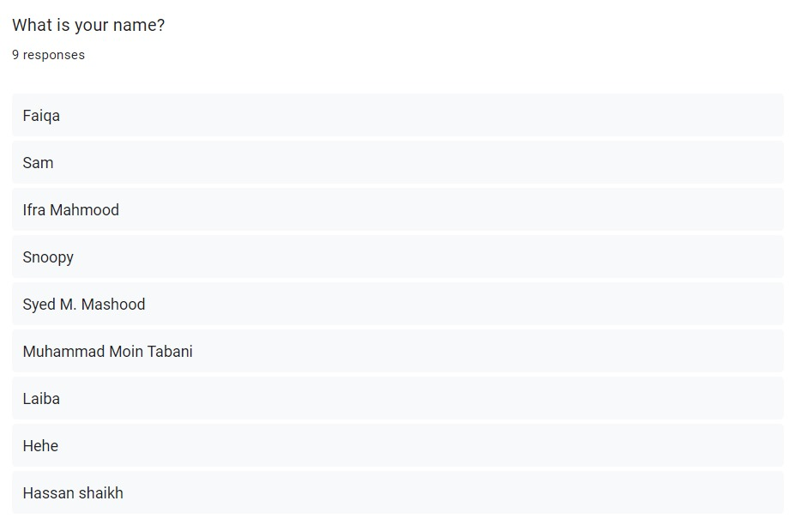
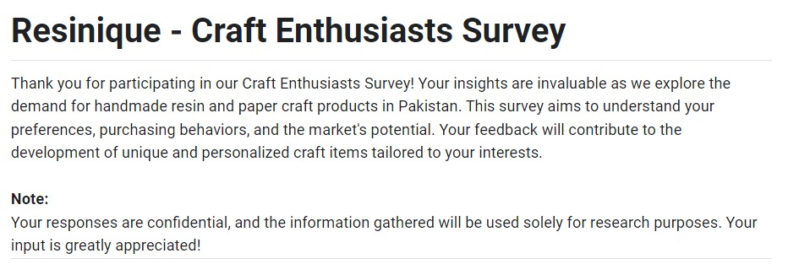
SURVEY

Slide 17
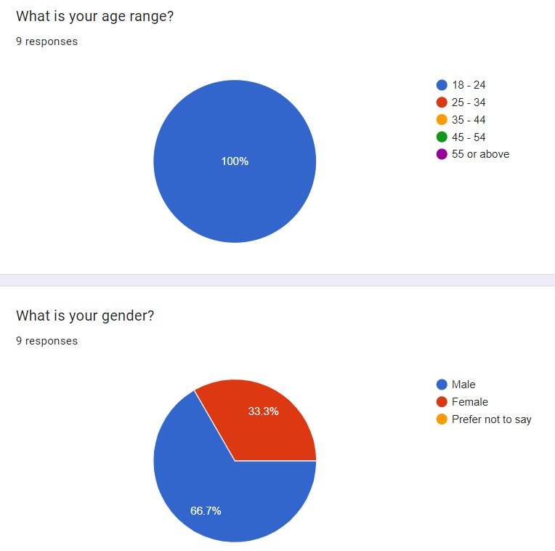
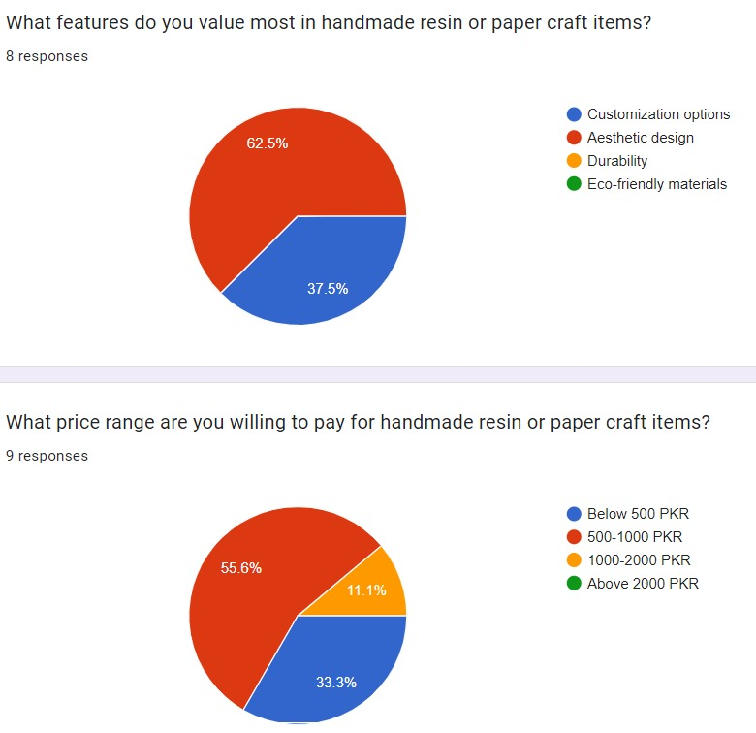
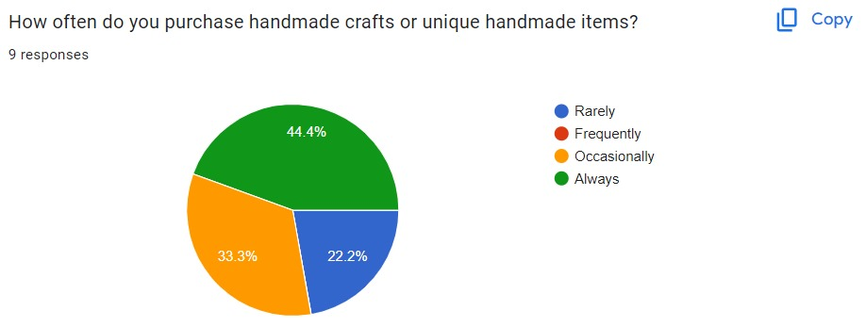
SURVEY STATES

Slide 18
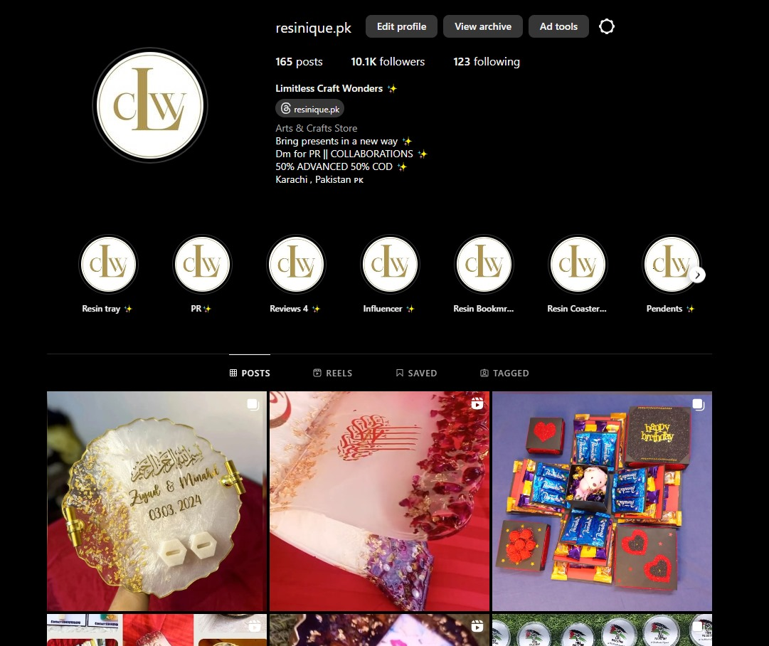
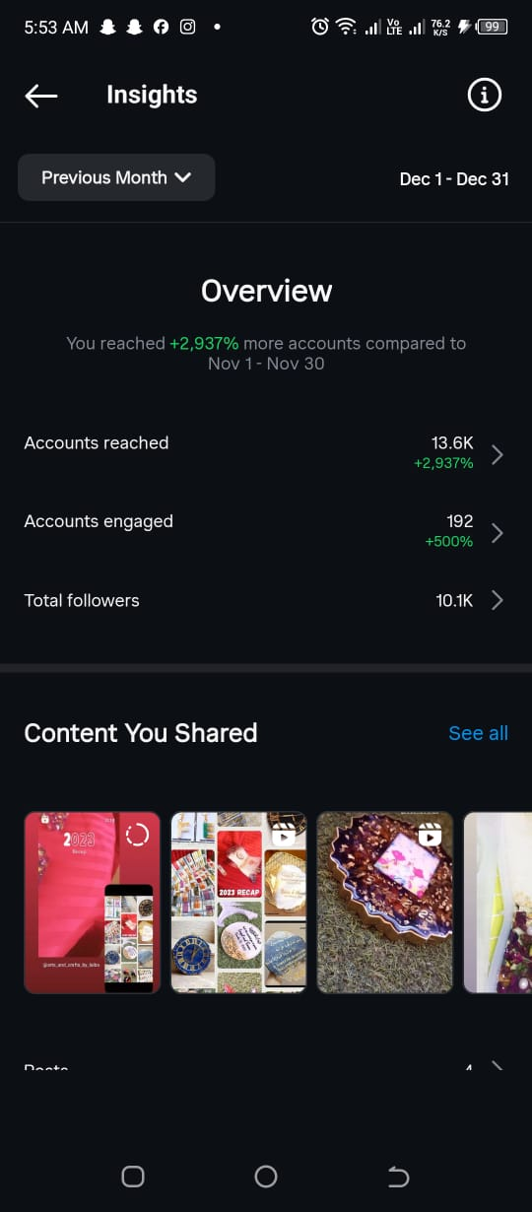
OPERATION

Slide 19
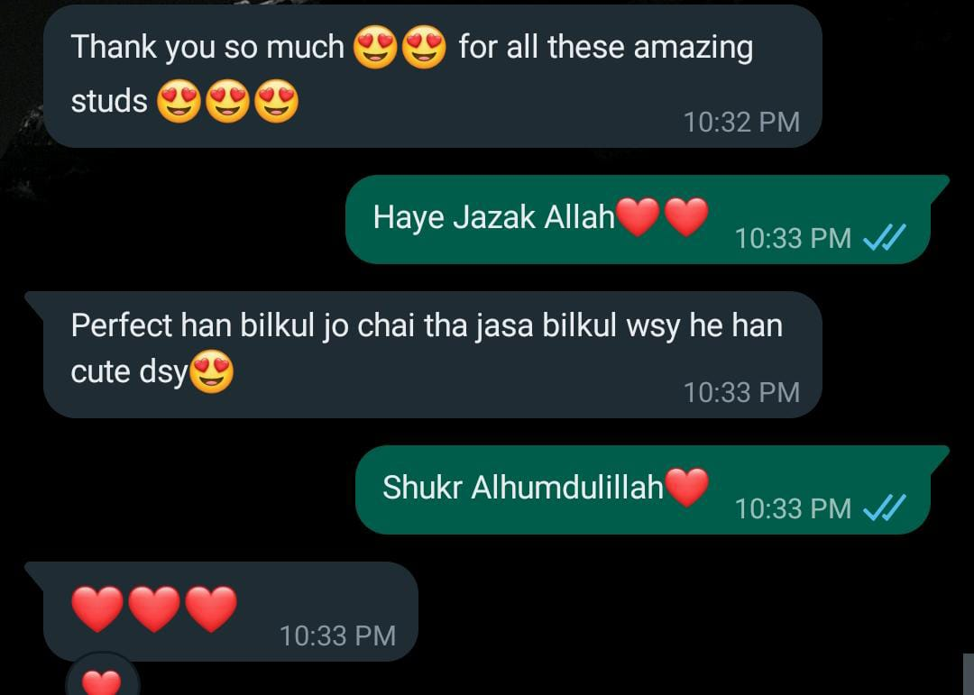
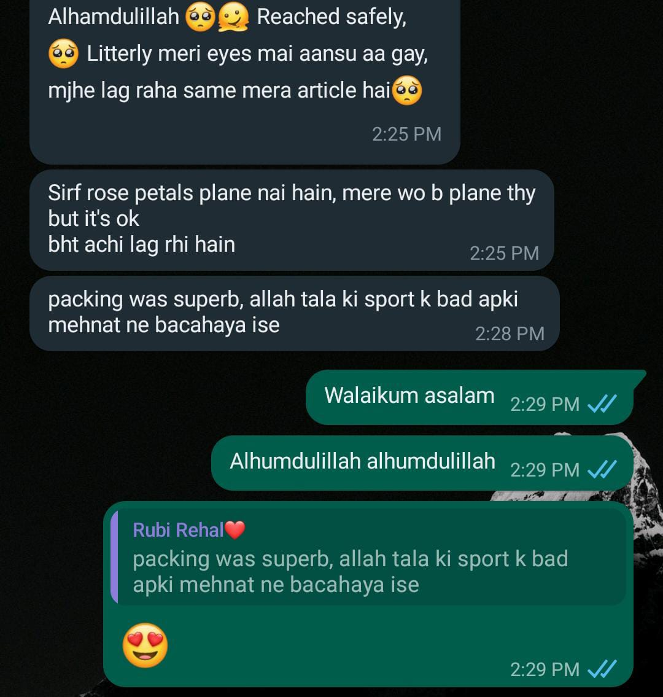
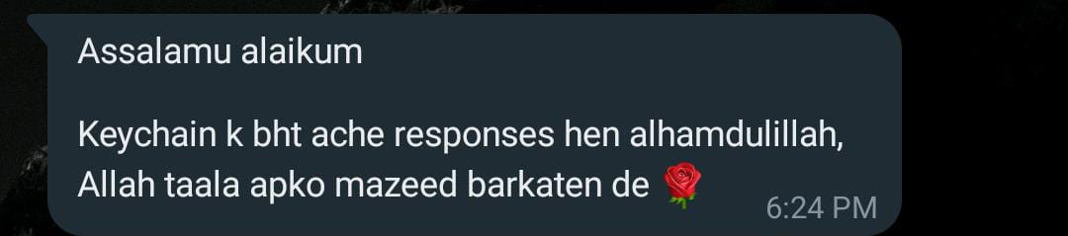
REVIEWS

Slide 20
PAYMENT PROOF

Slide 21
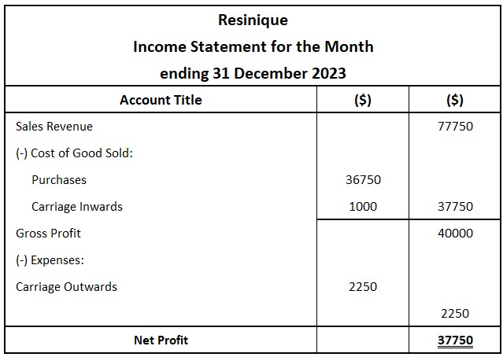
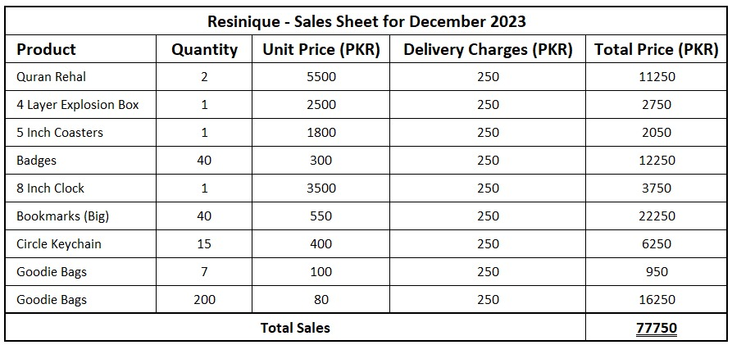
FINANCAL STATEMENTS

Slide 22
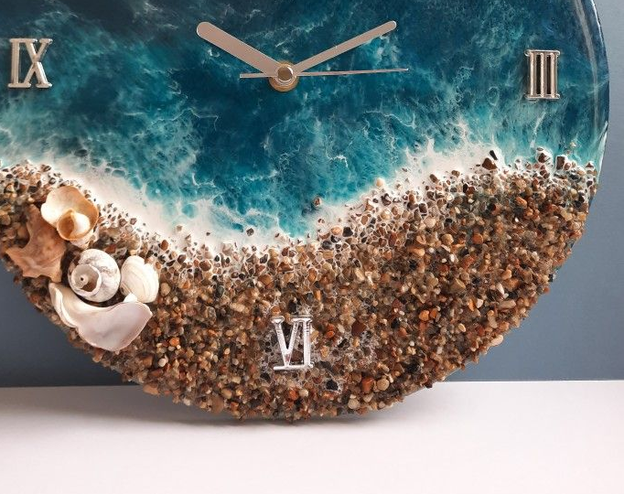
REFRENCES
Facebook
https://www.facebook.com/profile.php?id=61555290137986
Website
https://20b-083-cs.wixsite.com/resinique
Instagram
https://www.instagram.com/resinique.pk/

Slide 23
